Slide 1

HCI - Assignment n.2
Design and prototyping of an application using a human-centered approach
Final Presentation
Project Title: Key Vault Games
Group: Nuno Carvalho (97783), João Gaspar (107708) & Guilherme Santos (107961)
Lab Class: P5
HCI 2023-2024

Slide 2

Introduction
Key Vault Games
Online game key platform with interactive functionalities, like detailed search, discounts, quizzes, rewards or livestreams.
We like videogames, so we created a game key shop with some innovative aspects that help the user know better which games/keys to purchase.
HCI 2023-2024
2

Slide 3

Project Objectives
Key Vault Games
The goal is to have a platform for both casual players and hardcore gamers to use and decide which games to buy or not.
We expect people to use our platform more than the others available, since it offers the opportunity to play any kind of game, with a much more interactive experience.
Good offers and discounts, interactive quizzes to get rewards, detailed descriptions and even game livestreams are some of the benefits that differentiate our app from any other.
HCI 2023-2024
3

Slide 4
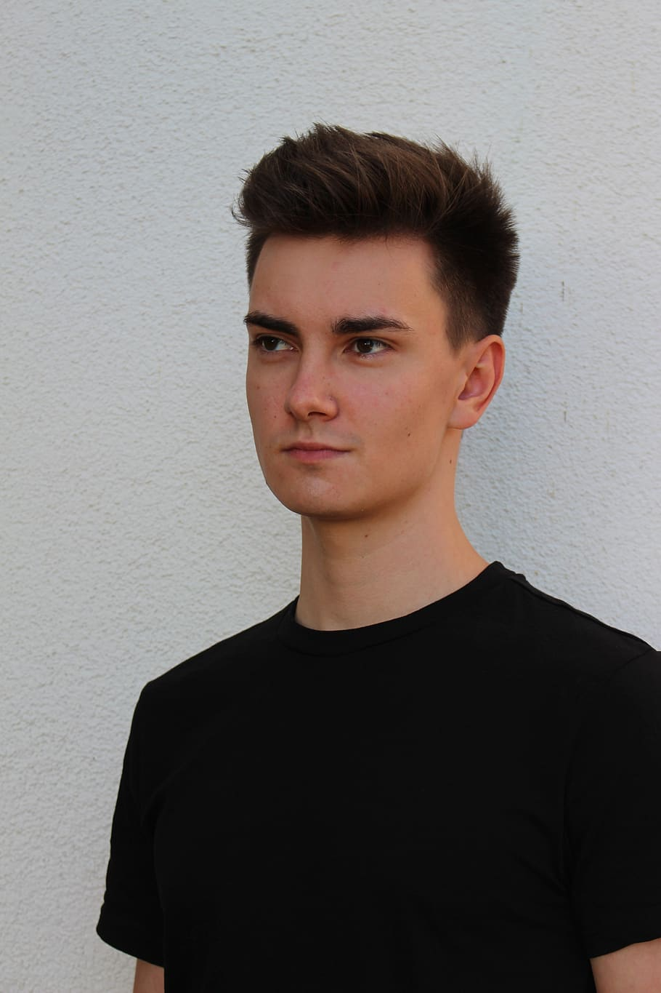

Personas & Scenarios
Key Vault Games
Name:
André Gonçalves
Discount Hunter:
André is looking for a game for his brother Rúben at Key Vault Games. He takes a quiz and gets a 20% discount. He searches for games under €30 with multiplayer options. After reading reviews, he buys an adventure game using the discount and receives the game key via email.
Name:
Filipa Soares
Games Analyst:
Filipa visits KeyVault Games to learn more about a game recommended by friends. After reading the description and watching a livestream, she decides to buy the game.
HCI 2023-2024
4

Slide 5
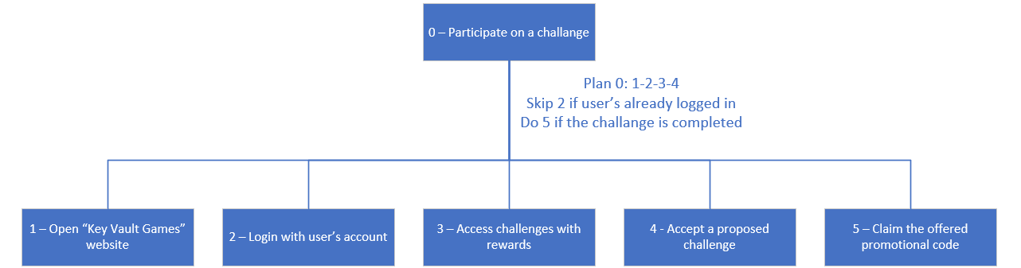
Tasks - Discount Hunter (André)
Key Vault Games
HCI 2023-2024
5

Slide 6
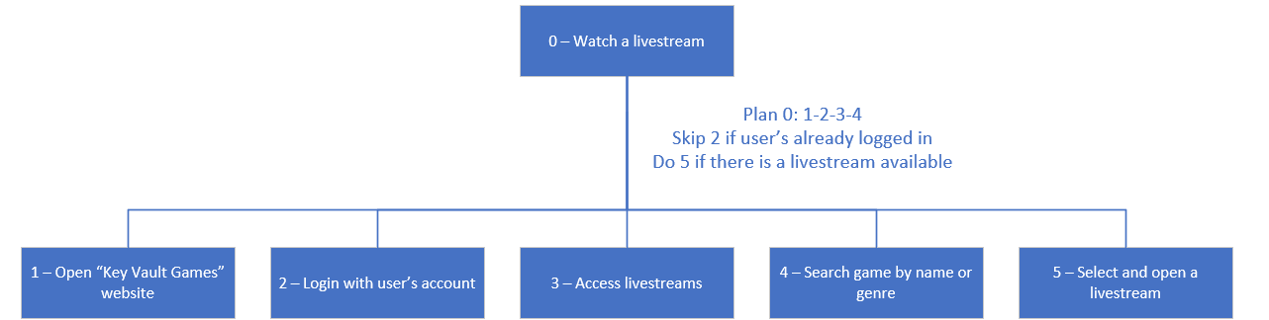
Tasks - Games Analyst (Filipa)
Key Vault Games
HCI 2023-2024
6

Slide 7
Requirements
Key Vault Games
Functional
Searching for games in the catalog by title;
Filtering games by genre and price;
Each game should have a description;
Creating a user account;
Deleting a user account;
Accessing and completing quizzes and/or missions;
Accessing livestreams;
Offering promotional codes to users based on the completion of quizzes and missions;
Purchases should accept promotional codes;
Returning a game key at the end of a successful purchase.
Non-Functional
The page loading time should be short;
Encrypt game keys and user passwords in the database;
It should be accessible regardless of the browser and operating system used;
The interface should be easy to understand, even for users with different levels of technology experience;
Game payment should be secure;
The user must authenticate the account before it can be used.
HCI 2023-2024
7

Slide 8
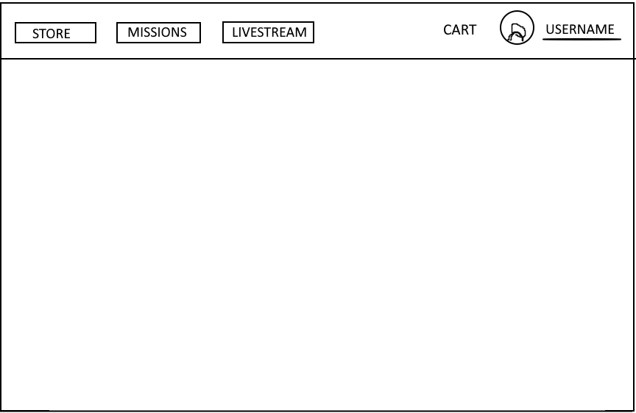
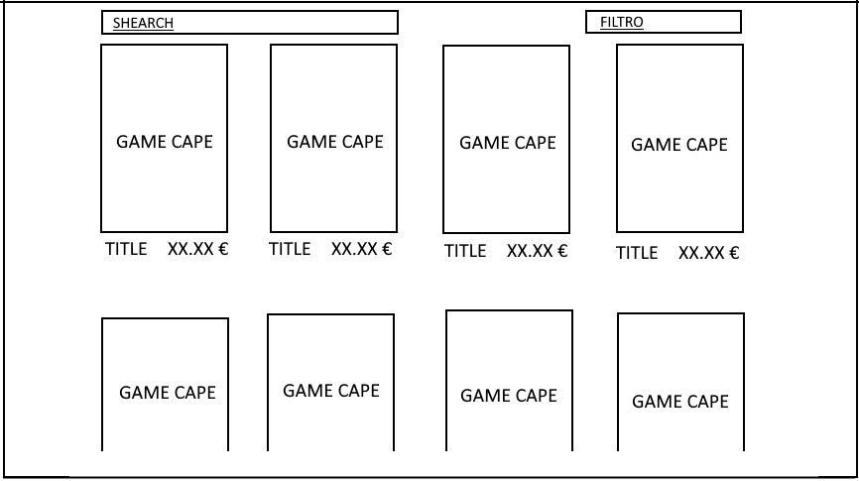
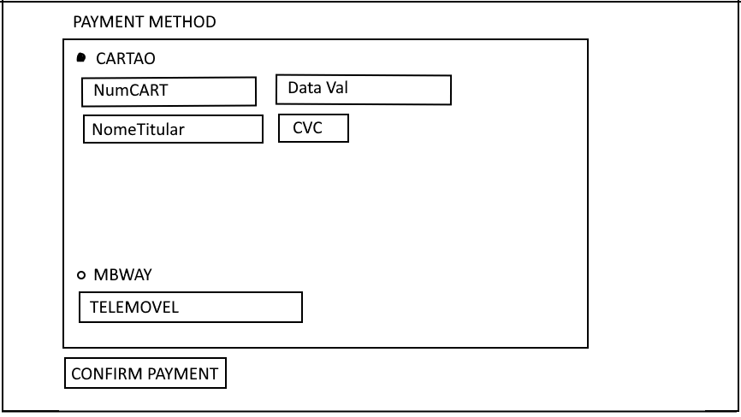
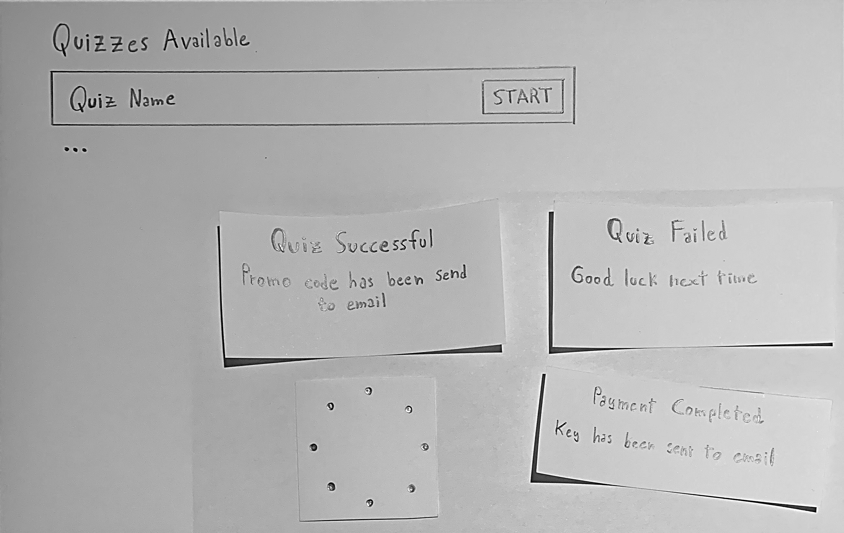
Low Fidelity Prototype (LFP)
Key Vault Games
Paper prototype.
To prepare the low fidelity prototype we simplified things as possible.
Core functionalities represented:
Navigation bar;
Seeing the games available;
Payment method;
Quizzes available.
HCI 2023-2024
8

Slide 9
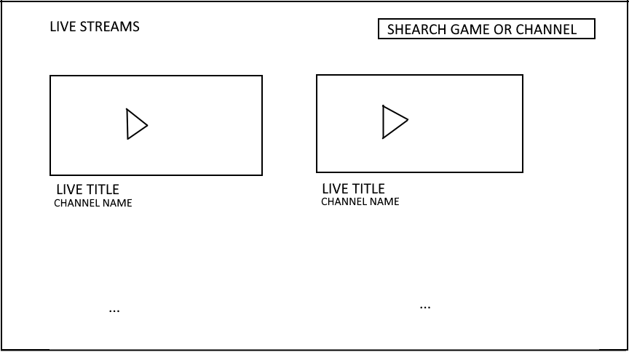
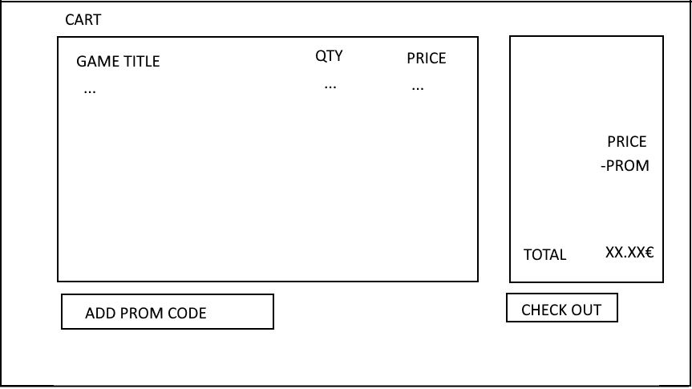
LFP – User Evaluation
Key Vault Games
We decided to create a paper prototype as it is quicker to produce than any computer implementation, allows for easy modification of the prototype, helps us identify errors, and enables us to evaluate the ease and intuitiveness of navigation.
Chosen tasks:
Find the cheapest game in the "FPS" genre;
Watch a livestream of that game;
Add it to the cart;
Complete a quiz and redeem a code;
Make the purchase by applying the promotional code.
HCI 2023-2024
9

Slide 10
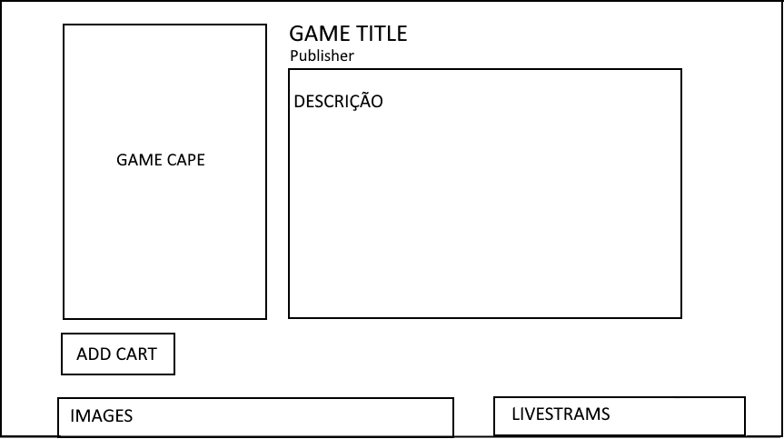
LFP – User Evaluation
Key Vault Games
Total number of participants: 6
Main results:
It was concluded that the low fidelity prototype was easy to use by all participants;
One of the participants suggested adding a “purchase history” page to the customer profile.
HCI 2023-2024
10

Slide 11




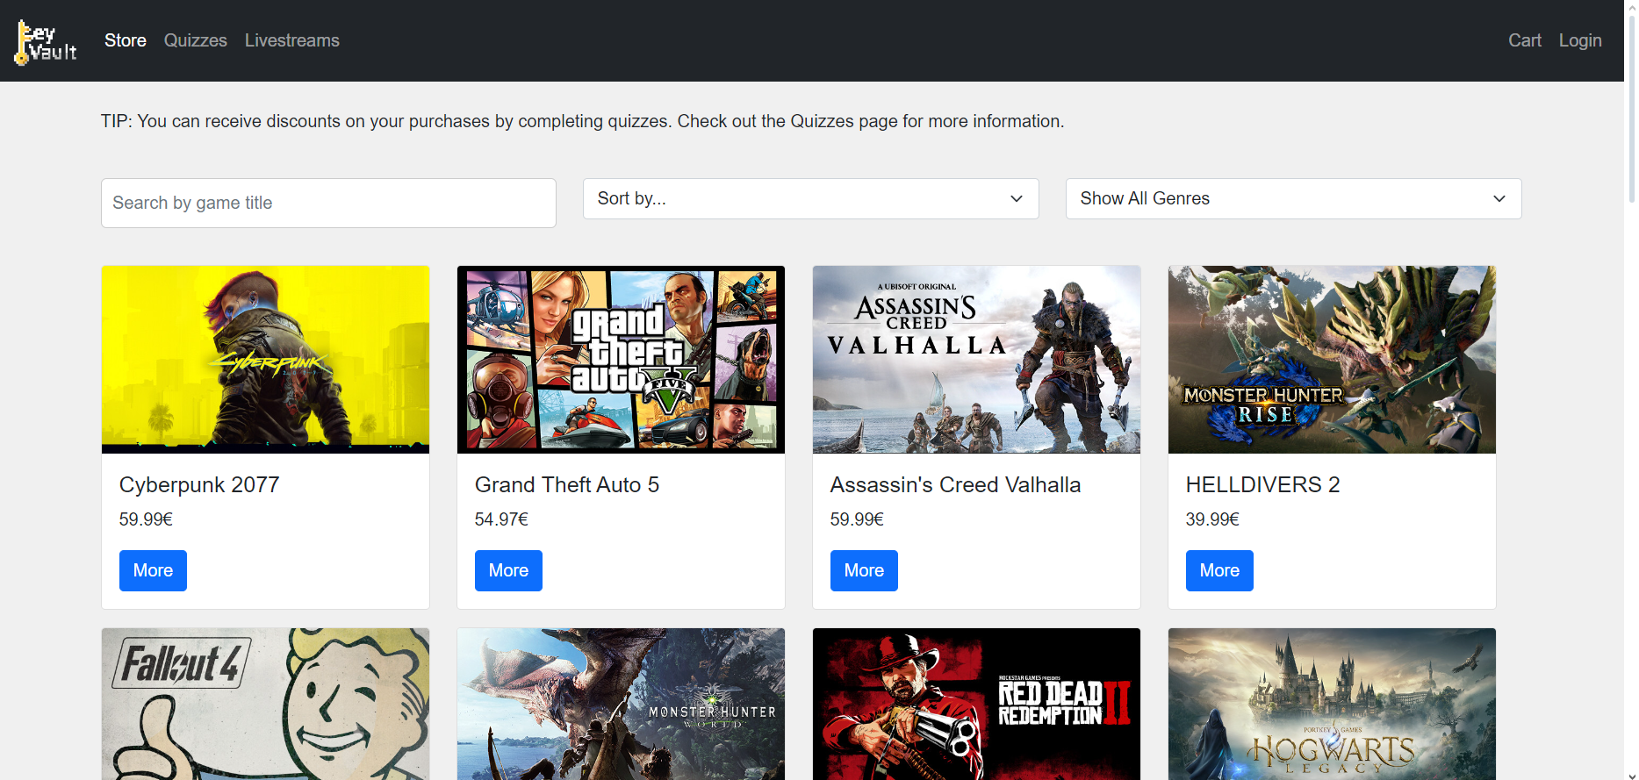
Plataform Used for Functional Prototype (FP)
Key Vault Games
Due to being an online platform for both PC and mobile users, the functional prototype was developed using HTML, CSS, and JavaScript as well as Python for creating a server.
For the server, we used the following open-source libraries:
Flask;
sqlite3;
os;
json.
It was tested on Windows operating systems.
HCI 2023-2024
11

Slide 12

FP – User Evaluation
Key Vault Games
A user evaluation was carried out through a usability test with volunteer participants. First, an introduction to the application was provided. After signing the Informed Consent Form, users were allowed to freely acquaint themselves with the application. Subsequently, they were assigned tasks to complete, including:
Create a new account.
Find the cheapest game in the "FPS" genre. What is the name of this game?
Watch a livestream of the game.
Open the Quizz page and take the "Gaming Consoles" quizz to get a promotional code. What is the promotional code obtained?
Complete the purchase.
Both the observer and the participant completed questionnaires to gather results.
To view the full questionnaire forms, scan the QR code or press here.
HCI 2023-2024
12

Slide 13
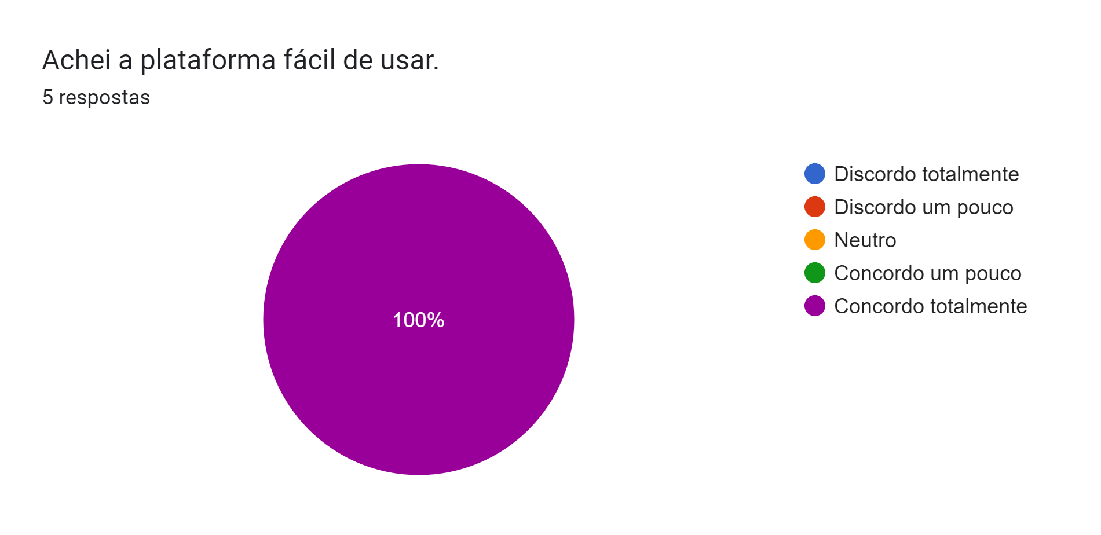
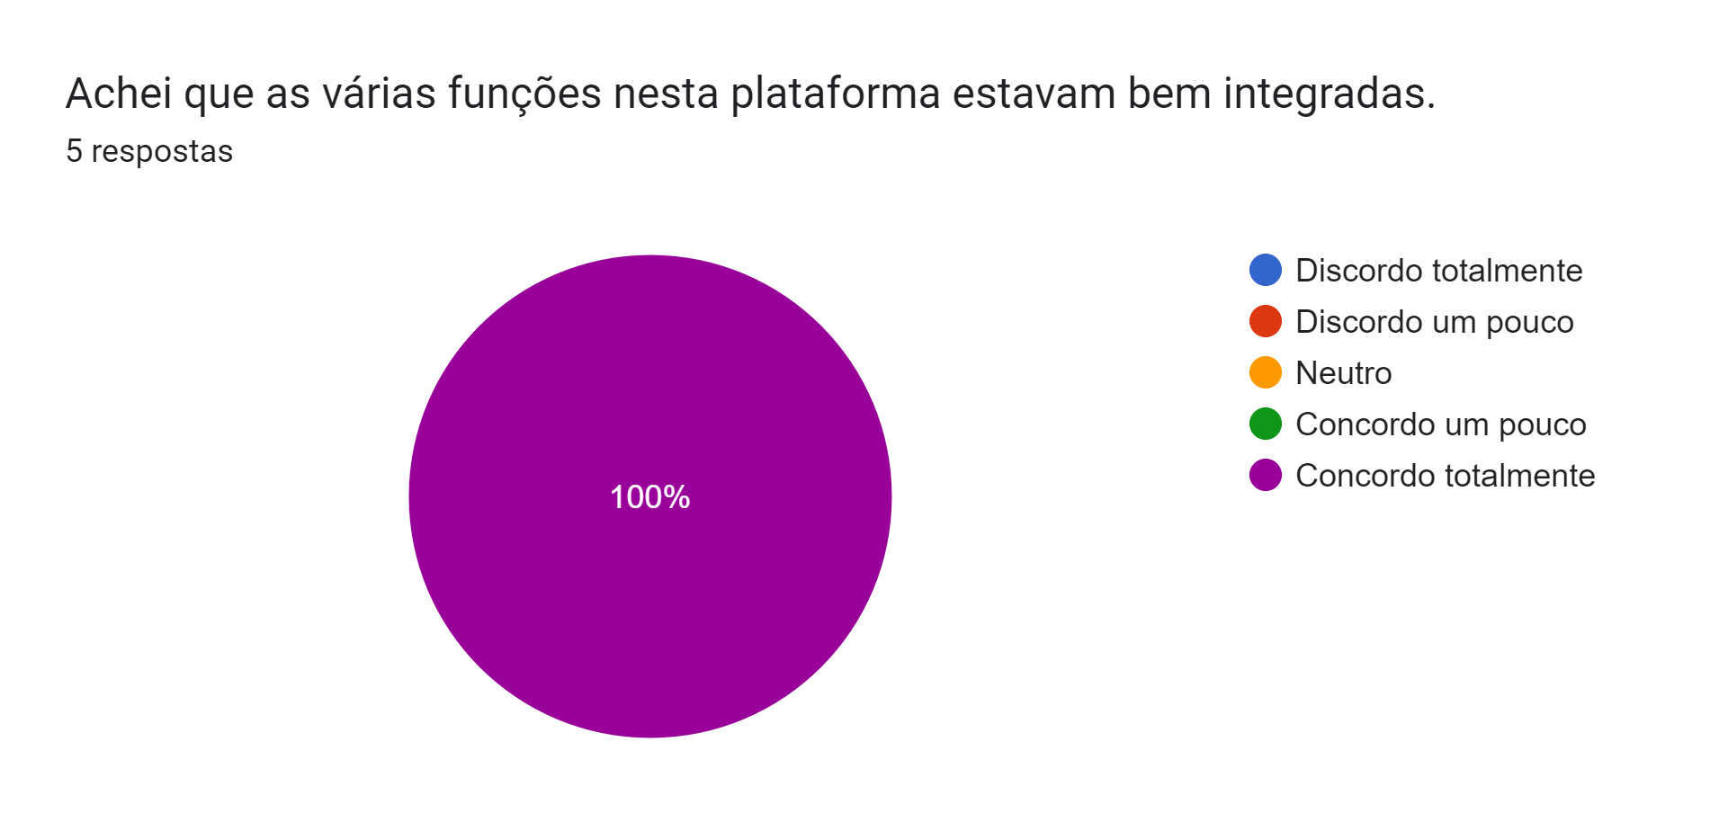
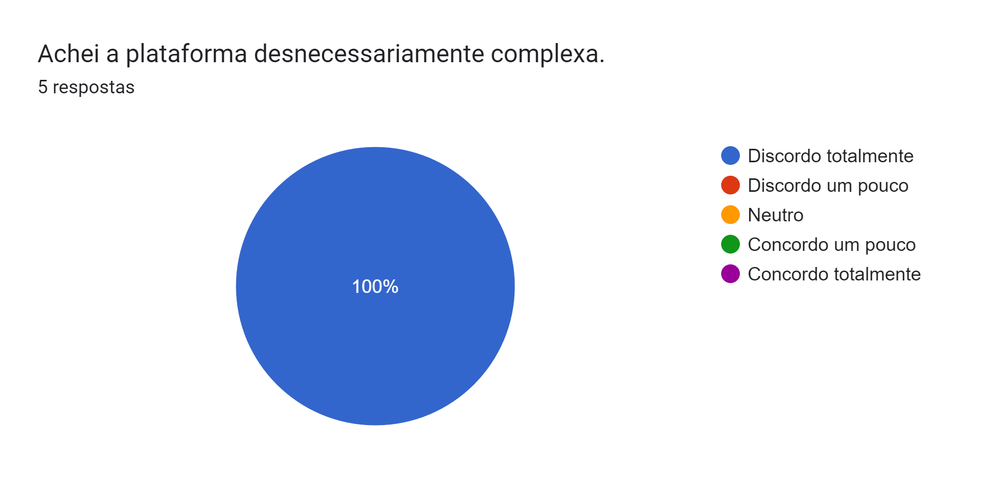
FP – User Evaluation
Key Vault Games
Overall, the users liked the platform and thought it was easy to use. However, there were some issues:
The “Buy Now” button caused some confusion, as some users thought they were going to buy a game, which isn’t the objective;
Problems with the discount code.
The images beside are in Portuguese because the tests were conducted with people who spoke the language fluently.
HCI 2023-2024
13

Slide 14
FP – Heuristic Evaluation
Key Vault Games
Issue: Promo Code
Heuristic: Recognition rather than recall;
Severity: 3;
Description: User might not copy the code and must retake the quiz to receive it again.
Issue: Registration Data Loss
Heuristic: Help users recognize, diagnose, and recover from errors;
Severity: 2;
Description: During registration, if the user makes a mistake, they must re-enter all data except the field they got wrong.
Issue: Non-Functional Edit
Heuristic: Visibility of system status;
Severity: 3;
Description: "Edit Profile" button is not working properly.
HCI 2023-2024
14

Slide 15
FP – Heuristic Evaluation
Key Vault Games
 | Guilherme | João | Nuno | Median
Promo Code | 3 | 3 | 2 | 3
Registration Data Loss | 2 | 3 | 2 | 2
Non-Functional Edit | 3 | 3 | 3 | 3
HCI 2023-2024
15

Slide 16
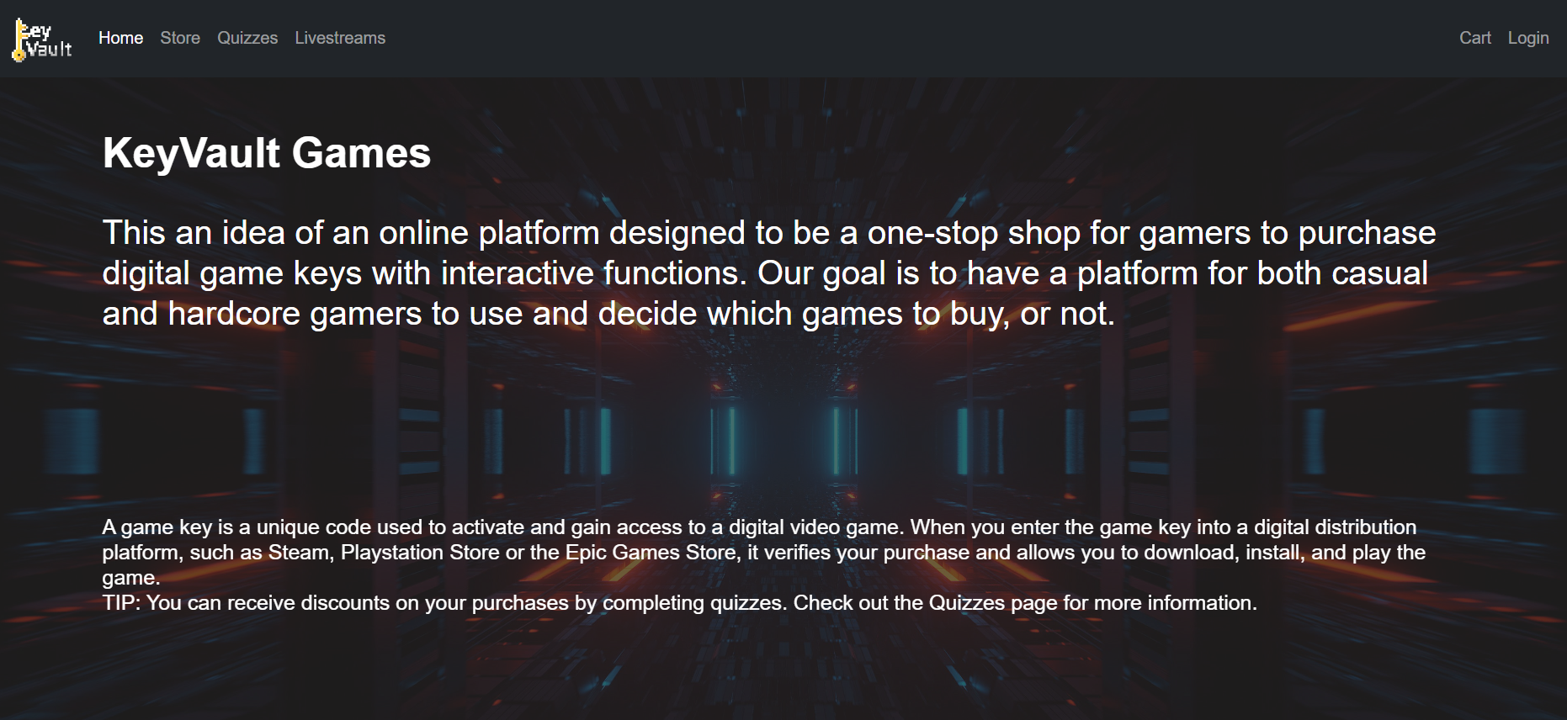
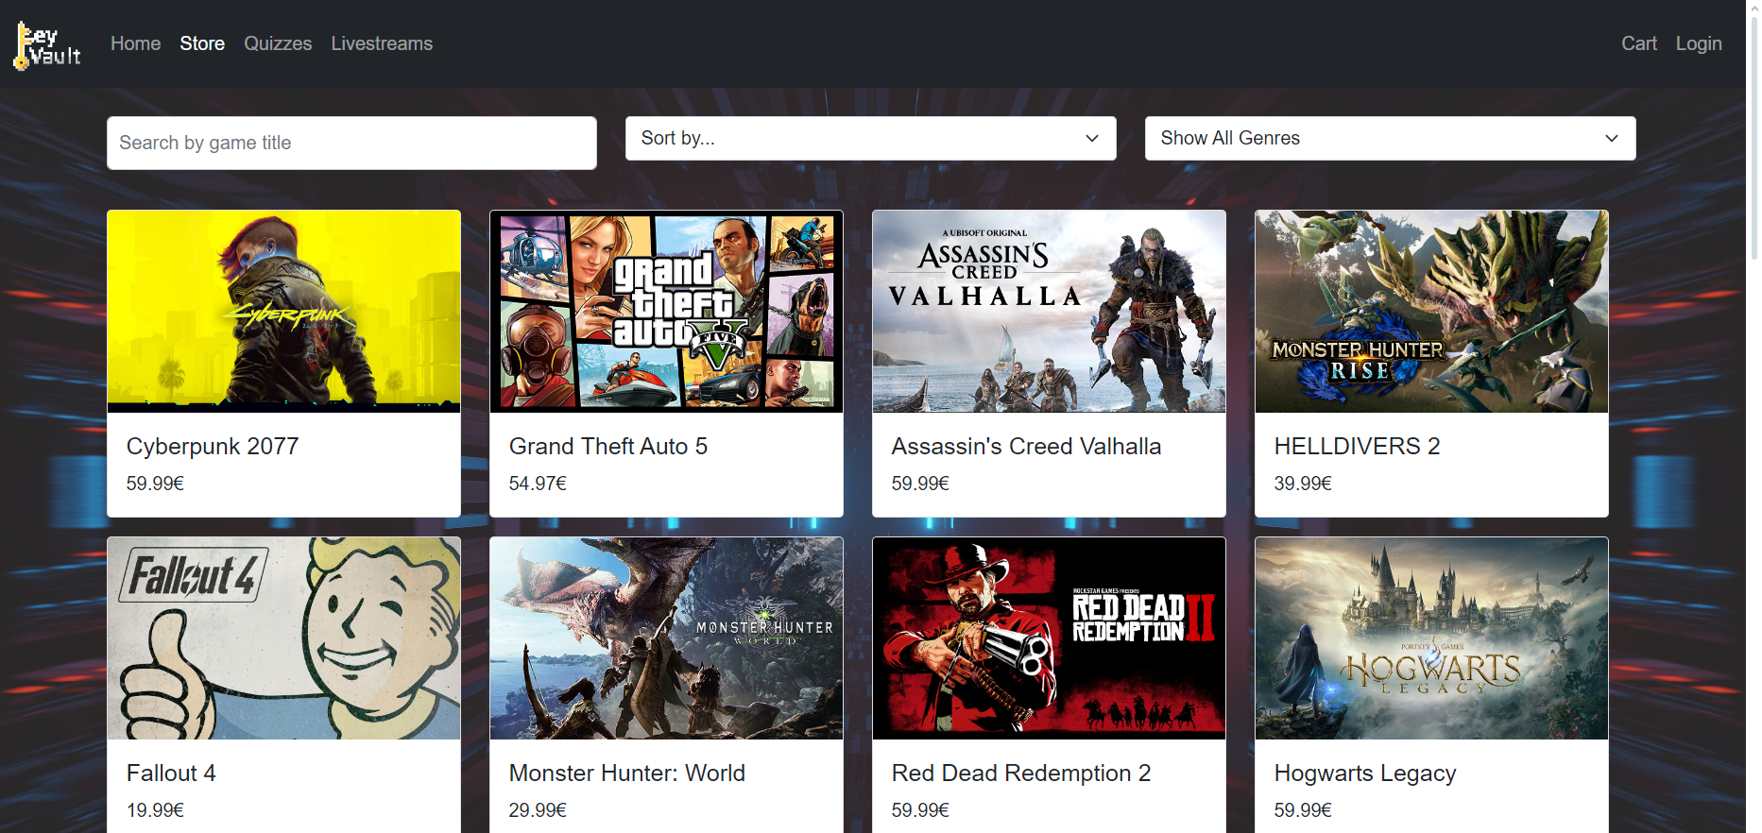
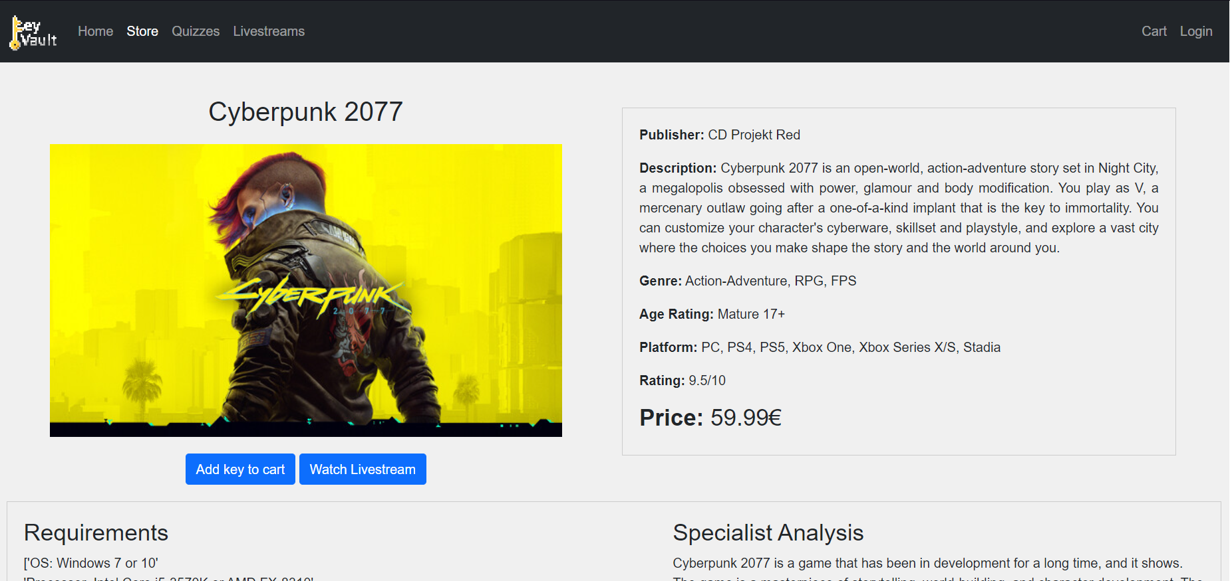
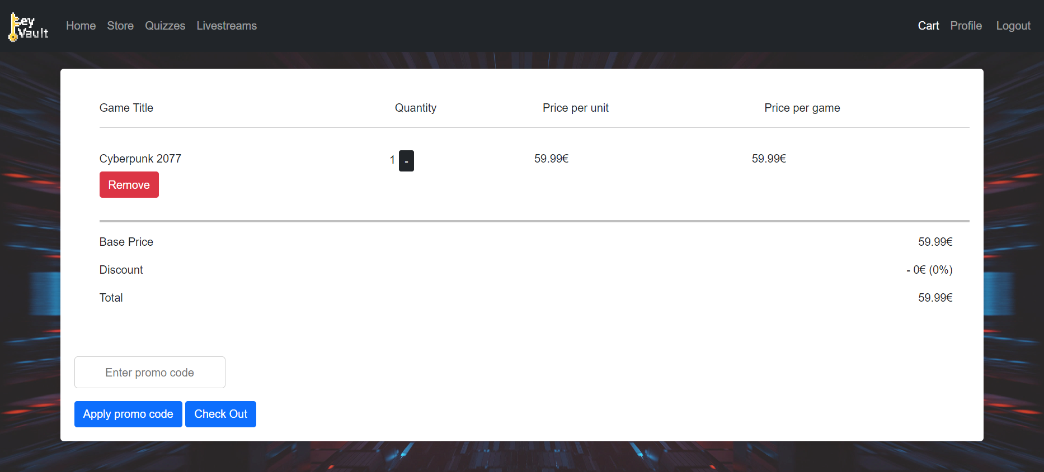
DEMO
Key Vault Games
HCI 2023-2024
16

Slide 17
Future Work
Key Vault Games
Implement the solutions from the remaining observations obtained in the Functional Prototype.
Add other possible payment methods.
Add an effect to the cart icon in the navigation bar that shows the number of items in the cart.
Implement more features for the user on the profile page (wish list, friends list, ....)
HCI 2023-2024
17

Slide 18
Effort
Key Vault Games
Nuno Carvalho – 25%
João Gaspar – 37.5%
Guilherme Santos – 37.5%
HCI 2023-2024
18

Slide 19
Thank you!
HCI 2023-2024
19

